Slide 1
DESIGN and ANALYSIS of ALGORITHMS HIMANSHU SRIVASTAVA CSE 2nd Year Roll no. : 181220031

Slide 2
Shortest Path Variants
Single-source shortest-paths problem
Single-destination shortest-paths problem
Single-pair shortest-path problem
All-pair shortest-paths problem

Slide 3
SINGLE SOURCE SHORTEST PATH
We have to find shortest paths from a source vertex v to all other vertices in the graph.
In a shortest- paths problem, we are given a weighted, directed graphs G = (V, E), with weight function w.
w : E → R mapping edges to real-valued weights.
The weight of path p = (v₀,v₁,..... v_{k}) is the total of the weights of its constituent edges.

Slide 4
SINGLE SOURCE SHORTEST PATH
We define the shortest - path weight from u to v by
δ(u , v) = min (w (p): u → v).
if there is a path from u to v, and δ(u, v) = ∞, otherwise.
The shortest path from vertex s to vertex t is then defined as any path p with weight w.
w (p) = δ(s , t).

Slide 5
DIJKSTRA’S ALGORITHM
Also known as Dijkstra's Shortest Path first algorithm
( SPF Algorithm ).
An algorithm for finding the shortest paths between nodes in a graph.
for example, road networks.

Slide 6
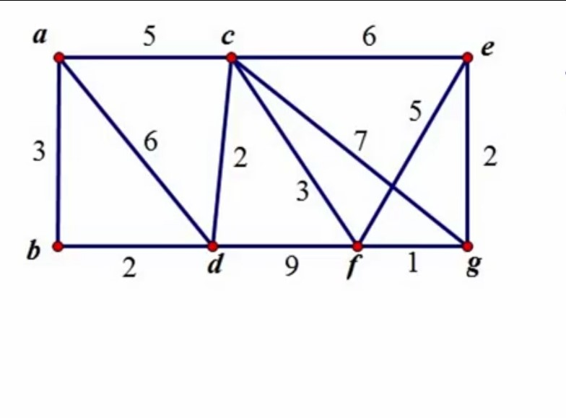
DIJKSTRA’S ALGORITHM
Find the shortest path from vertex ‘a’ to every other vertex for this graph.

Slide 7
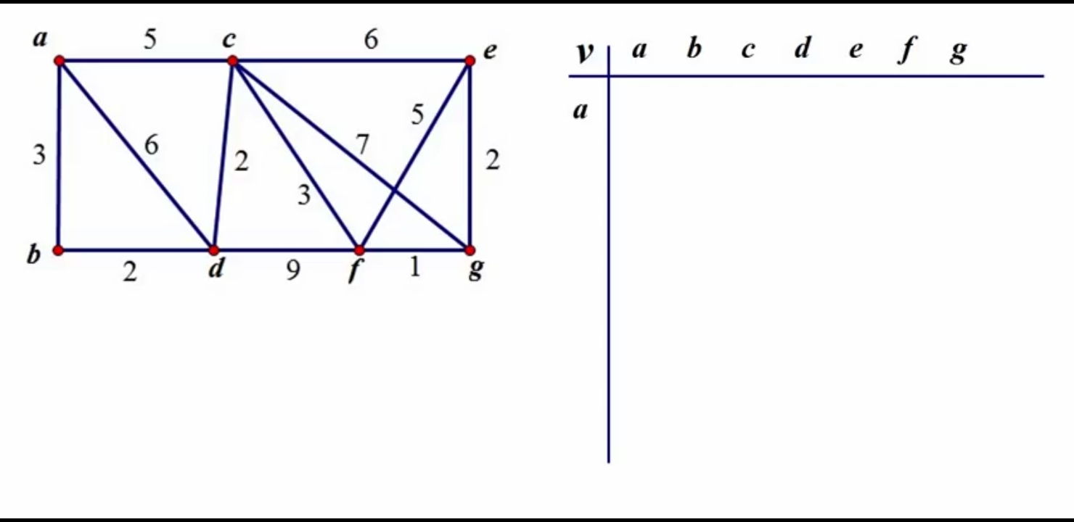
DIJKSTRA’S ALGORITHM

Slide 8
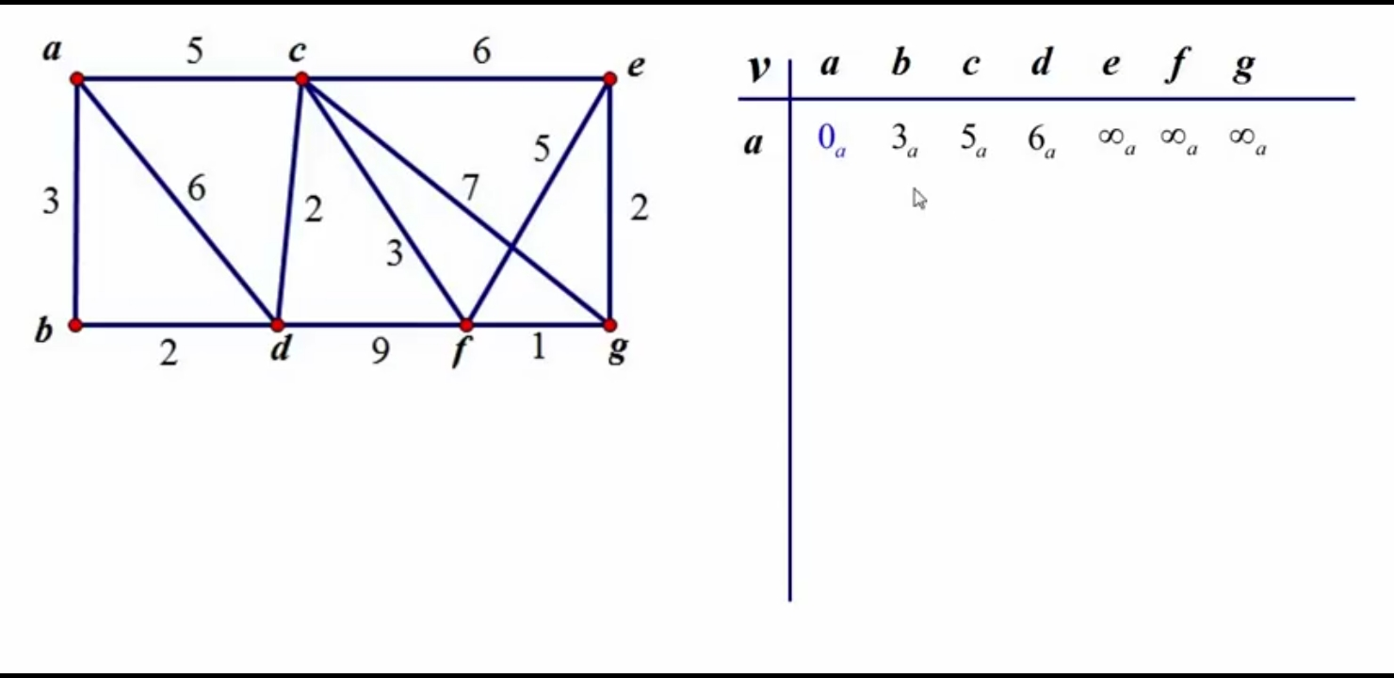
DIJKSTRA’S ALGORITHM

Slide 9
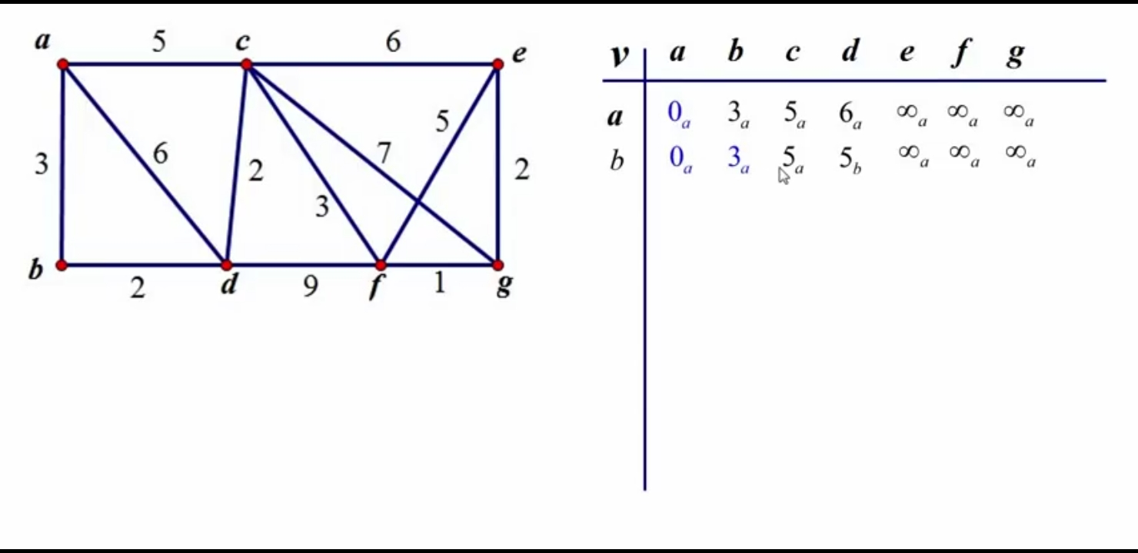
DIJKSTRA’S ALGORITHM

Slide 10
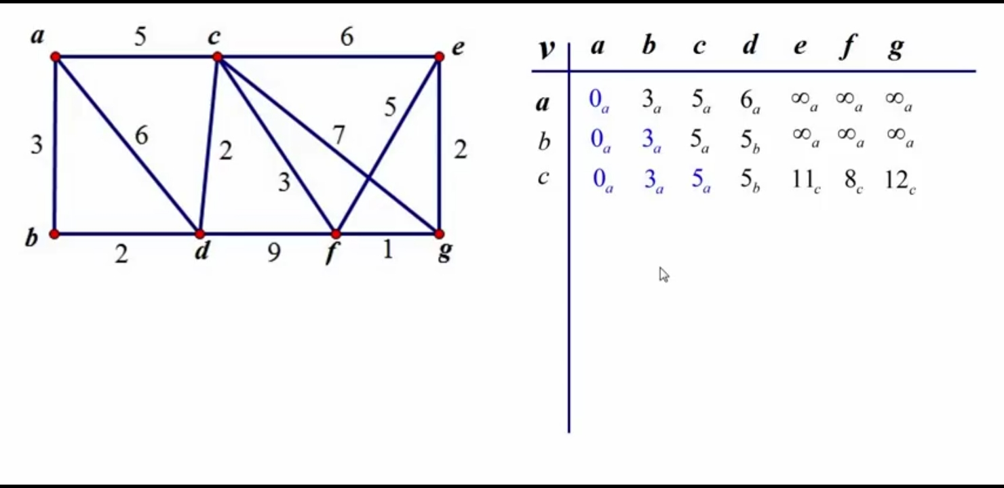
DIJKSTRA’S ALGORITHM

Slide 11
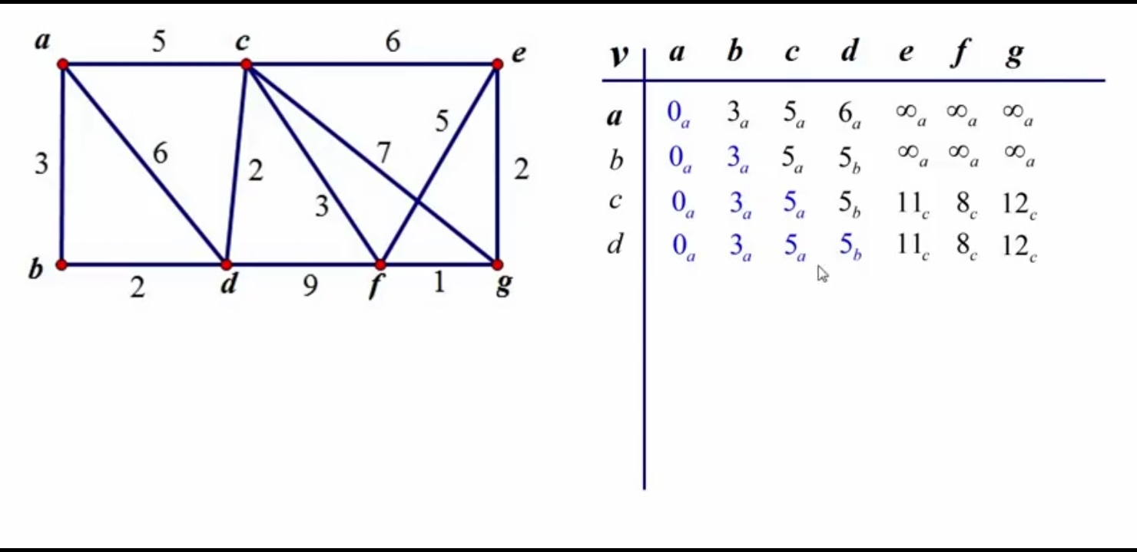
DIJKSTRA’S ALGORITHM

Slide 12
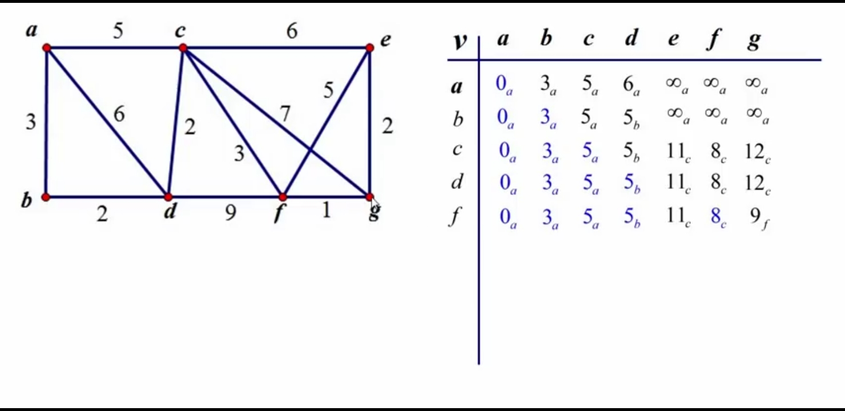
DIJKSTRA’S ALGORITHM

Slide 13
DIJKSTRA’S ALGORITHM
Time Complexity for Dijkstra’s Algorithm is given by
O( |V|² )
Using min heap time complexity can be
reduced to O( |V|* log(|V| )

